Slide 1
STAT7001 – Computing for Practical Statistics 2015 Lecture 4
Principles of Data Analysis
Dr Franz J. Király

Slide 2
Course organization updates
First In-Course-Assessment
Mistake in data generation: please re-download
if you have obtained tenants.xls on or before January 26
Submission deadline moved to February 23, 23:55 pm
Group work
Please inform us if you could not make contact with your group
Office hours
Monday, 3:15 pm – 4:15 pm after the lecture in my office (room 131)
I‘d prefer if you write an e-mail first, you get an answer faster that way
Friday workshop
Moved to Torrington Place 1-19 public cluster due to IT issues
in Foster court B29 public cluster only in weeks 27,30

Slide 3

STAT7001 course overview
DATA
Scientific Questions
R
SAS
Lectures 4,10
Methods
Exploration
Statistical Questions
The Scientific Method
Programming Skills
Lecture 2
Quantitative Modelling
Lectures 7,8
Lectures 3,5,7,9
Lect. 2,3,4, 7,10
Lect. 1,6,8
Descriptive/Explanatory
Predictive/Inferential
Scientific and Statistical Validation
Lect. 3,4,7,9
Knowledge

Slide 4
Clean Statistical Practice
Always know the context of your data
Why has your data been collected? What is the scientific context?
For exploratory purposes, or in a specific experimental design?
What do rows/columns/data points mean in real life?
How have the data been acquired? What are known/potential error sources?
Reproducibility – for yourself and others
Clear documentation: summary report, available well-commented code
Clear project structure: in description and in the R code
Clear and reproducible workflow: do not change the raw data
An experienced statistician should be able to re-do everything
Clear discussion and interpretation
Report/paper with short abstract, discussion of the data, question, results
Statistical report explains things you did, what you found, and what not
Clearly separate findings from their interpretation

Slide 5
Scientific Statistical Practice
Scientific Questions
Statistical Questions

Slide 6

The Scientific Method
quantative version
with Statistics!
Why did this apple fall from the tree?
Observation
Drop height/ strange British length unit
1.0 | 3.9 | 9.1 | 16.2 | 24.9
.1 | .2 | .3 | .4 | .5
Drop time/ weird British time unit
Hypothesis
Looks like height = 100 time² + residual
(I ran polynomial regression in R)
I hypothesize that this will be the case for any other height/time pair.
Prediction
Experiment
Drop height/ strange British length unit
35.9 | 49.2 | 64.5 | 80.5 | 101
.6 | .7 | .8 | .9 | 1.0
Average relative error = 1%
Drop time/ weird British time unit
A good fit!
Conclusion: Hypothesis confirmed. I think the reason might be an unspecified invisible force. Further investigation is needed. Increase height? Live specimens?

Slide 7
Context of Statistical Methods
„Observation“
= looking at the data without any prejudice or hypothesis
Descriptive Statistics: computing summary parameters (e.g. mean, variance)
to numerically describe the statistical behaviour
Exploratory Data Analysis: plotting the data (e.g. histogram, boxplot)
to visualize important features otherwise hidden
Always quantify!
(if possible & feasible)
„Experiment“
= asking the data a question for which it was specifically collected
This means that the question has arisen in observation of other data, so:
Either, the observation data set should be different from the experiment one
Or, the data set should be split into training/test set („out-of-sample-validation“)
Very rough rule-of-thumb is 80/20 split (80% training, 20% validation)
better: repetition and k-fold or leave-k-out cross-validation to obtain error bars
Always validate out of sample!

Slide 8
Finding the right questions, example: the pulse data
Main question: „Does running affect the pulse? If yes, how?“
„Observation“
„Do the males have lower pulse before, as compared to females?“
(yes/no)
Exploration: e.g. group-wise boxplot or density plot
Quantification: 2-sample-test, e.g. Wilcoxon signed rank
„Is there a relation between pulse before and pulse after?“
(yes/no)
(if yes what kind)
Exploration: e.g. scatter-plot, regression
Quantification: correlation, goodness-of-fit
„Experiment“
„Can we predict pulse before from gender, smoking and training?“
(how well)
Model: e.g. linear regression with categorical variables
Quantification: correlation or prediction error on 20% test data
„Does running influence how the pulse changes (before->after)?“
(yes/no)
Model: change in distribution
Quantification: Kolmogorov-Smirnov test before/after
Note: no training/test split needed, as data includes before/after

Slide 9
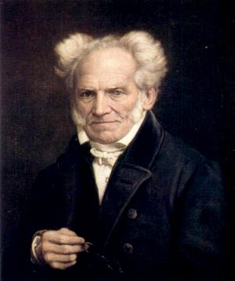
Why is the Prediction/Experiment part needed?
Why did this apple fall from the tree?
Observation
Curious – all these apples falling from the trees without anybody telling them
Hypothesis
A. Schopenhauer. Die Welt als Wille und Vorstellung But it’s crystal clear. The apple is falling to the ground because it wants to be there.
Prediction
… What’s a prediction?
A. Schopenhauer’s lab protocol, 1st of April 1819. Had a long discussion with several apples that they don’t actually need to be on the ground. Recommended them to read my books. They wouldn’t listen. Then went on a walk with my poodle.
Experiment
Conclusion: I am bad at convincing apples. I will let my good pal F. Nietzsche try next time.

Slide 10
On experiments and causality
… we examined various clinical parameters in representative populations of football fans (N = 1342) versus non-fans (N = 1313). Our study, heavily based on logistic regression, suggests…
Observation
Hypothesis
THE INFORMED OBSERVER
Prediction
WATCHING FOOTBALL
Experiment
CAUSES HAIR LOSS AND BALDNESS
Further dangers include prostate cancer and early death Famous statistician suspects “confounding” as mechanism
“I’m shocked”

Slide 11
An experiment, and its analysis, need to be carefully and specifically designed to minimize interference of unknown factors with question & answer
Always be aware of this when analyzing data. „How“ is discussed for example in STAT2002,3005,3008,7002,M002.
An informal declaration to yourself „I collect the data in order to…“ is not enough
Example: Does watching football cause hair loss?
The sample population needs to be randomized into a test and a control group.
otherwise properties of either of the two groups could influence the result
The test group should start playing after the experiment starts, the control group should never play at all (and a similar experiment with stopping should be made)
otherwise the cancer is not „caused“ nor „prevented“ by an action
The population should be as unaware (of the experiment) as ethically possible.
otherwise beliefs and expectations of the population could influence the result
The experimenters should be as unaware as functionally possible.
otherwise beliefs and expectations of the experimenter could influence the result
All this is known to cause problems in different scenarios if not addressed!

Slide 12
An example from last year‘s ICA
With coupon
Without coupon
mean purchase in bolívar
2734
1260
95% CI of mean
[2283,3623]
[965,1694]
„Customers spend (significantly) less when not using a coupon.
So handing out coupons increases customers‘ spending“
„Customers spend (significantly) more when using a coupon.
So customers use coupons more often when they spend more.“
Cum hoc non est propter hoc!
An association does not imply causation! Even if one variable is the hypothesized influetial one!

Slide 13
Advanced data manipulation
DATA
Exploration

Slide 14
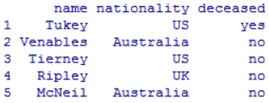
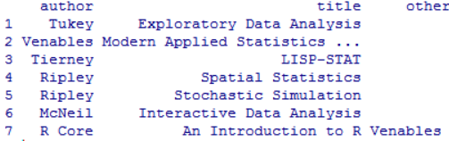
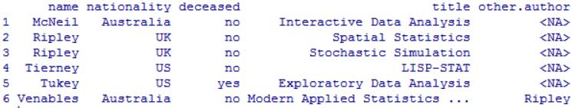
Joining multiple data sets
to get informative covariates from two (or more) data sets in one data set
authors
books
merged_frame
name
author
name = author
nationality
booktitle
nationality
booktitle
authors
books
merged_frame <- merge(authors,books,by.x="name",by.y="author")

Slide 15
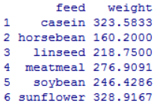

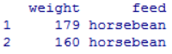
Aggregation of data
to combine information in two (or more) data points in one data point
chickens
ch_food
chickens
mean(weight)
feed = horsebean
weight
feed = horsebean
feed
feed
feed = soybean
feed = soybean
chickens
ch_food
ch_food <- aggregate(weight~feed,data=chickens,mean)
aggregates the „weight“ variable by mean w.r.t. feed as stratum
i.e., mean is computed for feed = sth, then ch_food contains for each feed the mean
cbind(varname1,varname2)
makes a joint variable out of two
many-to-many-aggregation can be achieved by
aggregate(cbind(var1,var2)~byvar1+byvar2, etc)

Slide 16
Exploration revisited
Exploration
Statistical Questions

Slide 17
Exploratory Data Analysis in R
1. Understand your data
What are the contents, variables in your data
How and for which purpose was the data collected
2. Load the data into R
Inspect the data file first: what is the format? Possible errors?
3. Inspection of single variables – of all (if there‘s not too many)
Summary statistics: 5-number summary, mean, variance
Stem-and-leaf display, box-plot, histograms, density plots
4. Bi- and multivariate inspection
Contingency tables, mosaic plot, scatter-plot, Group stratified plots
5. Quantification of the above – always quantify
Association: suitable measures, e.g. covariance, Pearson or rank correlation
Difference: suitable hypothesis tests, e.g. t-test, Wilcoxon signed rank test
Blurred line towards modelling:
Advanced descriptive and predictive models, unspervised learning

Slide 18
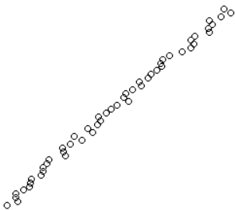
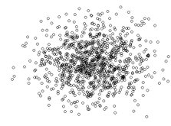
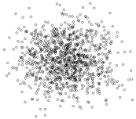
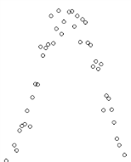
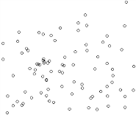

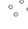
Common issues in data analysis
too many variables (>20)
Possible solutions:
split in semantic classes, class-wise analysis
advanced methods for dimension reduction and variable selection
collinearity
(e.g. among covariates)
Possible solutions:
take principal components; variable selection
advanced methods for dimension reduction and collinear data
clustering
(in generative or discriminative tasks)
Possible solutions:
try to identify clusters manually; subgroup analyses
advanced methods for clustering and classification
non-linearity
(in generative or discriminative tasks)
Possible solutions:
univariate variable transformation, dimension reduction
advanced methods for non-linear data analysis and prediction
outliers
Possible solutions:
remove, outlier-stable methods
advanced methods for outlier detection

Slide 19
Missing values
R knows two different kinds of missing values:
NaN
„not a number“
reserved for ill-defined computation results
NA
„not available“
this should be assigned when importing missing data
the fact that a variable is missing is an important variable itself
when noticeable amount is missing, this needs to be studied!
Missing completely at random?
Missing at random, depending on sth?
Association of missingness with values of variable, or other variables?
To obtain logical variable describing missingness:
framename$varismissing <- is.na(framename$var)
or simply use is.na(framename$var) in the analyses
(similarly is.nan)
To omit data points with NA from the analyses:
(difference = residuals & prediction)
na.omit(framename)
or
na.exclude(framename)
most R functions have a parameter na.action = which can be set similarly

Slide 20
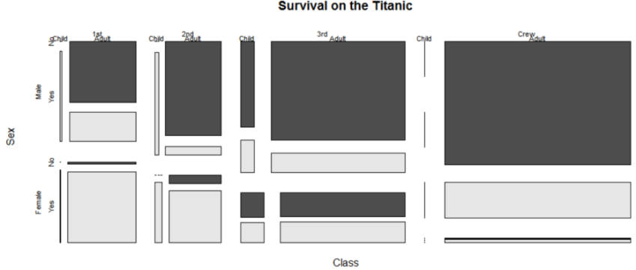
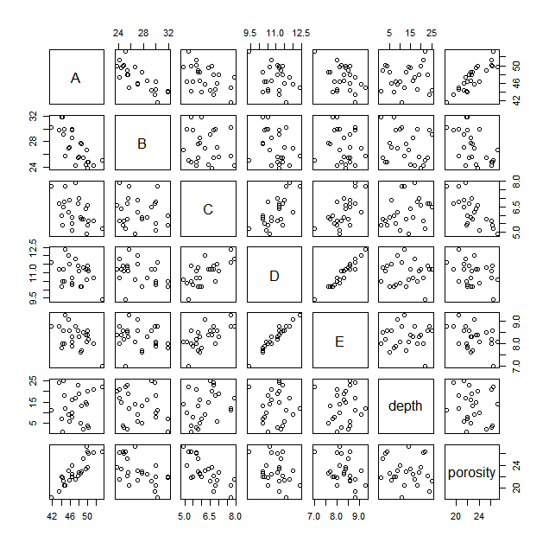
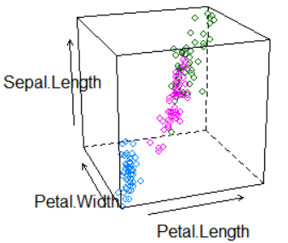
Tri- and multivariate exploration
Simultaneous inspection and plotting of three or more variables
discrete variables: mosaic plot
mosaicplot(~var1+var2+var3, etc)
(sequence of variables determines plot)
continuous variables: scatter plot matrix
pairs(~var1+var2+var3, etc)
(sequence of variables determines plot)
pairs(dataframe[,vars], etc)
Alternative: splom in lattice
continuous variables: 3d scatter plot
cloud(etc)
in lattice package
discrete/continuous:
subgroup analyses

Slide 21
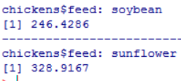
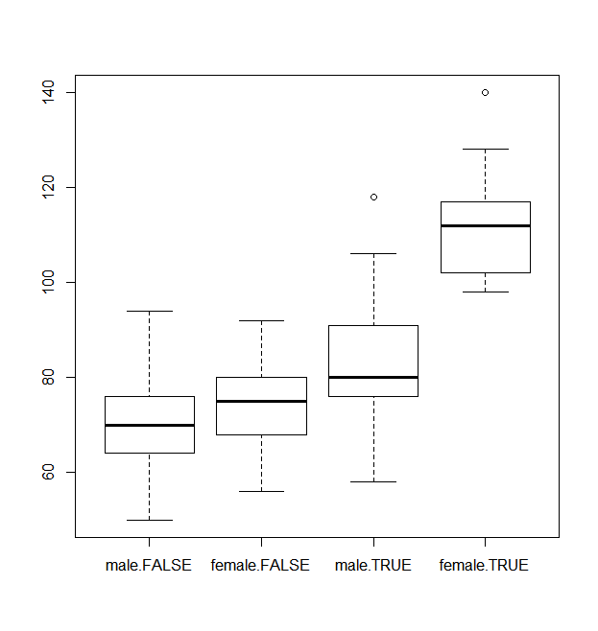
Subgroup analysis
looking for relations and dependencies in stratified subgroups
tapply
applies a function to each element of an array
by
applies a function to sub-data-frames by groups
by(chickens[,-"feed"],chickens$feed,mean)
if plotting command takes a formula:
function(formula=target~by1+by2|groups, etc)
Stratified boxplot
boxplot(formula= etc)
Group-wise t-test
t-test(formula= etc)
lattice library offers stratified exploratory plots for:
histograms
histogram
density plots
densityplot
QQ-plots
qq
scatterplots
xyplot
boxplots
bwplot
example(plotname)
library(lattice) to load the package, then

Slide 22
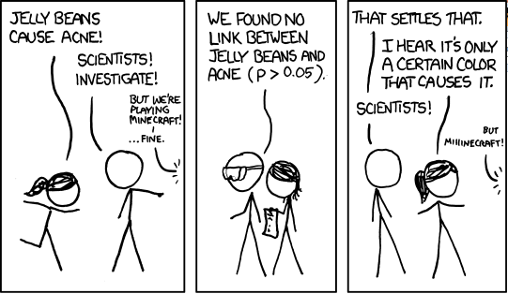
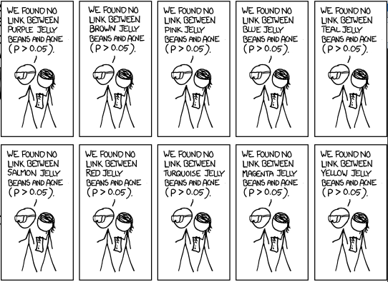
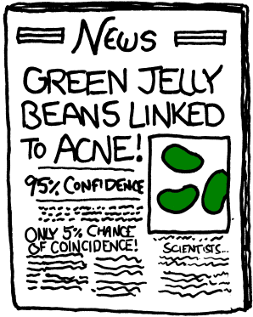
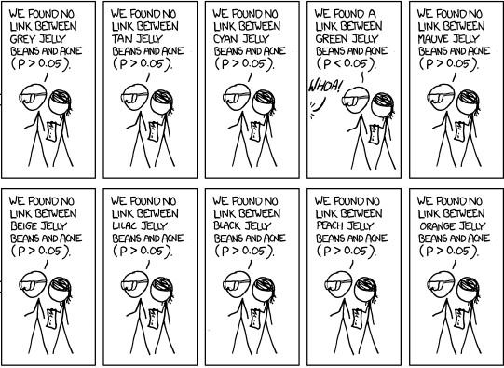
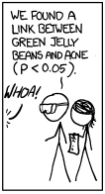
always do multiple testing correction for significance for the number of analyses you actually did, not only reported ones

Slide 23
Interpretation and reporting

Slide 24
Interpretation of results
Put your findings into the scientific context:
Does your model describe a relationship/association? A dependence?
Has it been obtained from a question or from exploration?
Does it explain anything? Does it predict anything?
Have you tested it on unseen data, out-of sample?
If yes, it has the status of an experiment.
If not, it has the status of an observation.
When testing: specify significance level in advance
It is clean practice to do so before you do any tests, explorative or not
Rule-of-thumb: if lifes depend on it: 1% or less; if explorative: can do 5% or higher
Separate facts from interpretation and opinion
Carefuly be aware what your analysis tells you and what not!
Correlation is not causation! An observed relationship might not be causal.
List potential causes clearly as what they are: potential causes.

Slide 25
Interpretation: UCB admissions example
We investigated data on all N=4526 applications to graduate research degrees at UC Berkeley in 1973. The data included information on gender of the applicants (male/female), the application department (A to F), and whether the application was rejected or not.
We found that there a significant overall association between female gender and rejection (OR 1.84 ± 0.12, p < 2e-16).
BAD:
Since rejection cannot cause the gender, the gender must be related to the reason for the female applicants being rejected more significantly.
WORSE:
Cause/effect is not part of the data!
The cause for this to the best of our knowledge is
the known lower academic capabilities in females as compared to males.
Or: the known ongoing discrimination of female applicants during application.
Neither „academic capabilities“ nor „discrimination“ was part of the data!
(the above non-sequiturs have been part of the actual historical discourse on the UCB data set and do not reflect UCL’s or the lecturer’s view on the data or associated questions)
Data is apolitical!
Conclusions must be scientific!

Slide 26
Interpretation: UCB admissions example
We investigated data on all N=4526 applications to graduate research degrees at UC Berkeley in 1973. The data included information on gender of the applicants (male/female), the application department (A to F), and whether the application was rejected or not.
We found that there a significant overall association between female gender and rejection (OR 1.84 ± 0.12, p < 2e-16).
BETTER:
We found that this overall association can be mostly explained by stratification into the six different departments, for which both rejection rate and the female/male ratio vary considerably.
Fitting logistic models over all parameters and Analysis of Deviance revealed that gender is no longer a significant overall model parameter (p = 0.22) when controlling for department.
However, the interaction terms department/gender in the models remain significant (p = 1.1e-03) in all models, indicating possible department-specific preferences – depending on department, favouring either males or females.
(always stay clear about what is possibe explanation, and what is analysis)
We recommend close monitoring and future acquisition of department-specific data.
(optional; if you make recommendation, make clear that it is not part of the factual analysis!)

Slide 27
Writing a statistical report
Summarize data, experiments, findings, interpretation
Suggested structure:
Top of your report: summary/abstract
Interpretation/recommendation, if applicable
Relation to prior analysis/literature - not needed for ICA
but otherwise mandatory!
Description of your data: variables, structure, acquisition, cite source (study or project)
Description of your analysis: questions, numbers, outcomes
Interpretation of your results, discussion and outlook
Appendix: description of file structure, code location, repository of results
attach your code and analyses for reproducibility (e.g. as a file on CD)

Slide 28
Next Week: Generalized Linear Models
Methods for non-linear fitting
Regression for nominal variables

Slide 29
Week 4 Learning Objectives
Understand the Scientific Method
How to formulate and answer statistical questions?
Quantification and validation
Presentation of findings and their interpretation
Data manipulation
Joining data sets by fields
Aggregation by factor variables
Advanced exploration techniques
Recognizing common issues in data
Missing data, multivariate exploration, subgroup analysis

